Slide 1
Metallic Bonding

Slide 2
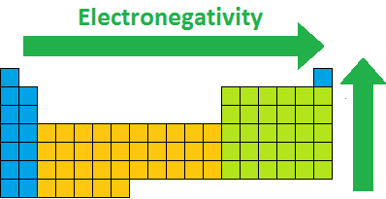
In order to fulfil the octet rule metals need to lose electrons.
Fortunately this is very easy, since metals have such a weak hold on their valence electrons!
Metals tend to have low electronegativity, and therefore only pull in electrons weakly.

Slide 3
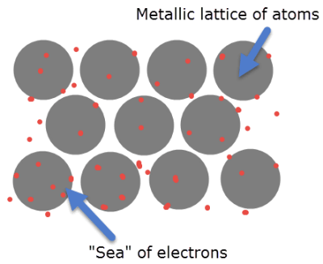
Metals bond through metallic bonding.
In metallic bonding the valence electrons are free to move from atom to atom, forming what is known as a "sea" of electrons.
Each metal atom is positively charged, but surrounded by negative electrons, so the net charge is neutral.

Slide 4
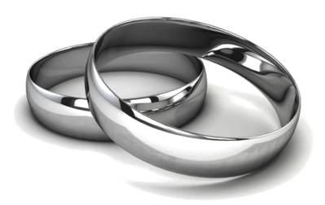
This "sea" of electrons explains many of the properties of metals.
Electrons which are not bound to an atom (free electrons) absorb and reflect light effectively. The electron "sea" is made up of free electrons, so metals appear shiny, or lustrous.

Slide 5
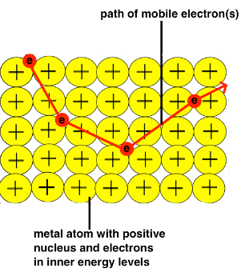
Electricity is the movement of electrons, so the free electrons in metallic bonding can conduct electricity by flowing out as new electrons flow in.
Electrons can carry heat energy, so the free electrons can quickly conduct heat throughout the metal.
An electron added to one part of the metal can freely move to any other part of the metal.

Slide 6

Metals are malleable and ductile because free electrons have no defined arrangement around the metal atoms. As they have no set position, the free electrons can easily adapt to form new shapes.
In comparison, ionic and covalent bonds have to be arranged in a specific order and their compounds will shatter if you try to change this arrangement.

Slide 7

There is a very strong attraction between the positive metal atoms and the "sea" of negative electrons. Melting requires overcoming this attraction, which needs large amounts of energy.
The higher the melting point is, the more energy is needed to overcome this attraction.

Slide 8

Watch this video (4:04) for another explanation of metallic bonding.

